Slide 1
6th to 7th Transition Night January 24, 2024 Welcome to Cain!

Slide 2
Cain Middle School Administration
Principal - Mrs. Zabojnik
Assistant Principal (Students with Last Names A-Gl)
Ms. Butts
Assistant Principal (Students with Last Names Gm-Pa)
Mr. Medina
Assistant Principal (Students with Last Names Pb-Z)
Mr. Webb

Slide 3
Future Mustang Parents
We hope you are …

Slide 4
Future Mustang Parents
but we also understand that you are probably …

Slide 5
Future Mustang Parents
Middle School is your child’s opportunity to attend
Dances
Games
Performances

Slide 6
Future Mustang Parents
Middle School is your child’s opportunity
For a fresh start
To meet new friends
To gain more independence

Slide 7
Future Mustang Parents
Middle School is your child’s opportunity
To take on more responsibility
Elementary teachers chase down students, in middle school students will need to chase down their teachers
To take ownership of their grades and their education
Each student has 8 teachers
Each teacher has 185 students

Slide 8
CAIN MIDDLE SCHOOL COUNSELORS
Students with Last Names A-K
Carrie.Batson@rockwallisd.org
Students with Last Names L-Z
Maria.Carroll@rockwallisd.org

Slide 9
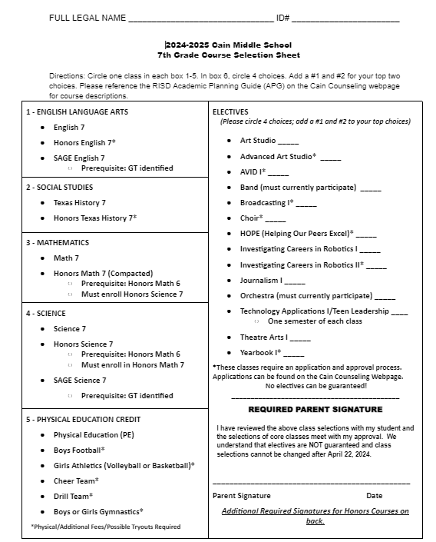
Each student went home with a purple folder yesterday.
Inside you will find this Course Selection Sheet along with a flyer that represents all of the elective choices.
This Course Selection Sheet is due to their Homeroom Teacher on February16.
All applications are due on February 16.

Slide 10
English
English
Honors English (agreement required)
SAGE English (must qualify)
Math
Math
Honors Math 7 (Compacted) (agreement required)
Should be in Honors 6th Grade Math
Must take Honors Science
Science
Science
Honors Science (Compacted) (agreement required)
Must take Honors Math
SAGE Science (must qualify)
Texas History
Texas History
Honors Texas History (agreement required)
Required Core Courses

Slide 11
Students and parents MUST sign required agreement on the back of the student choice form before being placed into a Honors class
You are making a year-long commitment to being in Honors
If you do not have the Honors Agreement signed then you will not be able to sign up for the Honors class.
Honors Courses

Slide 12
Boys Athletics Football only
Girls Athletics Volleyball and Basketball only
Drill Team Try Out Required
Cheer Team Try Out Required
Boys Gymnastics Try Out Required
Girls Gymnastics Try Out Required
PE I
All classes (other than PE) require a physical each year!
Physical Education Credit
Required Class

Slide 13
To start in Athletics, you MUST PLAY Football.
Students who do not want to participate in Football will have an opportunity to try-out for Basketball when the Football season is over (schedules will be changed into athletics during the year).
Tennis, Track, Cross Country, Wrestling and Soccer are before or after school - students DO NOT go into Athletics for these sports.
Boys Athletics
Boys Athletics Director
rickey.vanderburg@rockwallisd.org

Slide 14
Girls Athletics is for girls wanting to tryout for Volleyball or Basketball Only.
Volleyball Season is first
Offseason occurs when you are not playing the sport currently in season
Tennis, Track, Cross Country, Wrestling, and Soccer are before or after school - Students do not need to go into Athletics for these sports.
Girls Athletics Director
brittney.pike@rockwallisd.org
Girls Athletics

Slide 15
The primary purpose of the cheer team is to learn the importance of teamwork and promote school spirit and pride.
Mandatory Parent Meeting - Tuesday, Feb. 20th
Tryout Clinic Day 1 - Wednesday, Feb. 28th
Tryout Clinic Day 2-4: M-W, March 4th-6th
Tryout Day - Thursday, March 7th
Coaches
brooke.smith@rockwallisd.org
caitlyn.miller@rockwallisd.org
Cheer Team

Slide 16
The primary purpose of the drill team organization is to promote school spirit and pride while teaching teamwork and dance skills.
Parent Meeting - February 28 at 6:30 at Cain
Tryout Workshop - March 25 and 26 (4:30-6:30)
Tryouts - March 27 at 4:00
Drill Team
DRILL TEAM DIRECTOR - CHRISTINA.FRANKLIN@ROCKWALLISD.ORG

Slide 17
This course emphasizes the development of basic gymnastics skills, strength, and flexibility.
Gymnastics
Coaches:
Amy.Heidel@rockwallisd.org and James.Pershin@rockwallisd.org

Slide 18
Circle 4 choices; You will write in a #1 and #2 for your top two choices. Do not write in your #3 or #4 choice.
You will only get two out of your four choices.
All Applications are found on the Cain Website under 7th Registration.
If a class requires an application, you must submit it within the deadline or you will NOT be considered for that class
Students must be logged in to their RISD Student Account to complete the application. They cannot be turned in using a parent email address.
Electives
We cannot guarantee any electives; they are determined by class numbers and availability.

Slide 19
ELECTIVES
(Please circle 4 choices; add a #1 and #2 to your top choices)
Art Studio _____
Advanced Art Studio* _____
AVID I* _____
Band (must currently participate) _____
Broadcasting I* _____
Choir* _____
HOPE (Helping Our Peers Excel)* _____
ELECTIVES
(Please circle 4 choices; add a #1 and #2 to your top choices)
Investigating Careers in Robotics I _____
Investigating Careers in Robotics II* _____
Journalism I _____
Orchestra (must currently participate) _____
Technology Applications I/Teen Leadership ____
One semester of each class
Theatre Arts I _____
Yearbook I* _____

Slide 20
Forms due to Homeroom Teacher on February 16 (with parent signature).
All applications MUST be completed by Febraury 16th to be considered for a class that says Application Required. No exceptions! Applications are available on CMS Counseling Website, under the 7th Registration Tab or using the QR Code on the flyer.
Honors Course Agreement (back of Course Selection Sheet) MUST be signed before a student will be placed into a Honors course.
3 Important Things

Slide 21
Based upon preregistration information, courses are scheduled and teachers are employed for the next school year. Schedule changes are made under the conditions listed below:
• A change is needed as a result of summer school.
• A change is needed to balance classes within the master schedule.
• A change resulting in the revision of an Individual Education Plan (IEP) by an Admission, Review, and Dismissal Committee (ARD).
Schedule Changes
One of the most critical functions performed by a school is the preregistration of students.

Slide 22
All class descriptions can be found in the Academic Planning Guide.
All Applications can be found under 7th Grade Registration.
Applications must be completed by STUDENTS using the RISD student login. Ask your Homeroom teacher for help.
Cain Middle School Website
Click the Counseling Tab.
All Registration Information can be found here, including a copy of this presentation.

Slide 23
Core Subjects: Honors vs. On-Level

Slide 24
Making Wise Choices
Does your child have personal motivation to do well in school?
Does your child currently do his/her homework without reminders?
Does your child keep up with due dates on his/her own?

Slide 25
Making Wise Choices
Does your child want to be in Honors?
Will your child have to give up something he/she really wants to do in order to be successful in Honors?
Be sure to involve your child in the decision making process.

Slide 26
Making Wise Choices
Does your child miss school on a regular basis?
If so, then on-level classes are the best place for him/her.
Honors classes are much harder to keep up with because of the faster pace, class discussions, and new skills that are difficult for students to learn on their own.

Slide 27
Making Wise Choices
How does your child react when stressed or has a long to-do list?
The key is to find the right balance for your child when signing up for Honors classes…keeping him/her “challenged” but not “overwhelmed”.

Slide 28
Honors Texas History
How do I know my child is ready for Honors Texas History?
Reading level is 7th grade or higher
Passed Reading STAAR
Essay writing skills

Slide 29
Honors Texas History
How is Honors Texas History different than On-Level?
DBQ Essays
Every major grade is somehow different
More information to learn for example U.S. History as well as Texas
The test is worded differently so students must have a deeper understanding of the material
20-25 points of the grade would be a homework assignment

Slide 30
SAGE English
How is SAGE English different than Honors and On-Level?
Students must qualify to be in Sage
SAGE allows the district to cluster qualified students to best meet the social/emotional and academic needs of gifted learners in an assigned area
SAGE follows the same scope and sequence as Honors English

Slide 31
Honors English
How do I know my child is ready for Honors English?
Reading level is 7th grade or higher
Passed Reading STAAR
Willing and able to read novels at home

Slide 32
Honors English
How is Honors English different from On-Level?
Students will read at home, and come to class ready to discuss
Major grades are similar, but . . .
Stricter rubrics and higher expectations
More room for creativity and student choice

Slide 33
Honors English
How is Honors English different from On-Level?
Higher complexity for written assignments
Less scaffolding
Students will be expected to edit and revise their written work
Peer-to-peer analysis and cooperation

Slide 34
Honors Math
How is Honors Math different from On-Level?
On-Level Math
Focused on covering 7th Grade TEKS
Will take the 7th Grade Math STAAR
Honors Math
Touches on a few 7th Grade TEKS
Focuses on covering 8th Grade TEKS
Will take the 8th Grade Math STAAR

Slide 35
Honors Math
How do I know my child is ready for Honors Math?
Picks up on new math concepts quickly
Is able to work at a quicker pace than most
Self-Motivated to be successful

Slide 36
Honors Math
Things to consider with Honors Math
Classes are 45 minutes and much faster pace
After Honors Math is High School Algebra while in 8th Grade

Slide 37
SAGE Science
How is SAGE Science different than Honors and On-Level?
Students must qualify to be in Sage
SAGE allows the district to cluster qualified students to best meet the social/emotional and academic needs of gifted learners in an assigned area
SAGE follows the same scope and sequence as Honors Science

Slide 38
Honors Science
How do I know my child is ready for Honors Science?
Met standard or above on 5th grade Science STAAR
Has strong math skills
Has ability to learn new information at a fast pace
Has the willingness to put in extra study time outside of school

Slide 39
Honors Science
How is Honors Science different than On-Level?
Honors science covers 90% of the 7th grade science TEKS and 40% of the 8th grade science TEKS
The volume of what Honors Science learns far exceeds On-Level
There is no 7th grade Science STAAR but they will have to remember the information they’ve learned for the 8th grade Science STAAR
Honors Science and Honors Math are linked - If your child is in Honors Science, they must be in Honors Math and vice versa

Slide 40
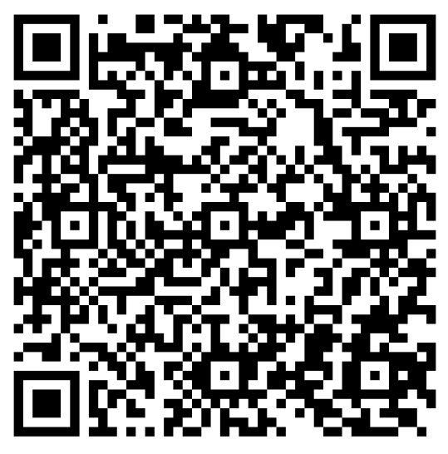
Honors Science
How will this impact which science courses my child can take in high school?
7th grade Honors Science is not a high school credit but IPC in 8th grade will be
Grades 7-12 Science Course Flow Chart

Slide 41
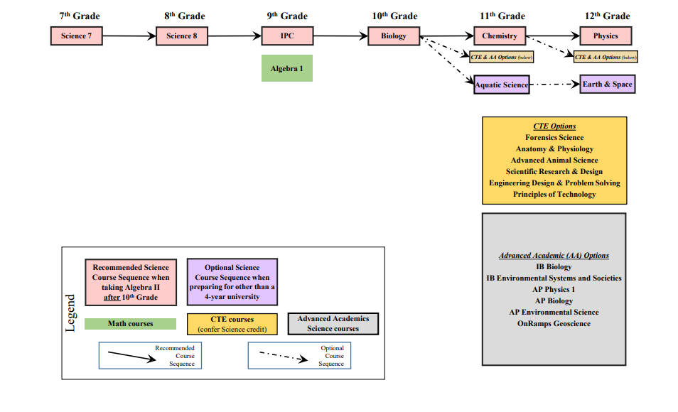
Honors Science: Option 1

Slide 42
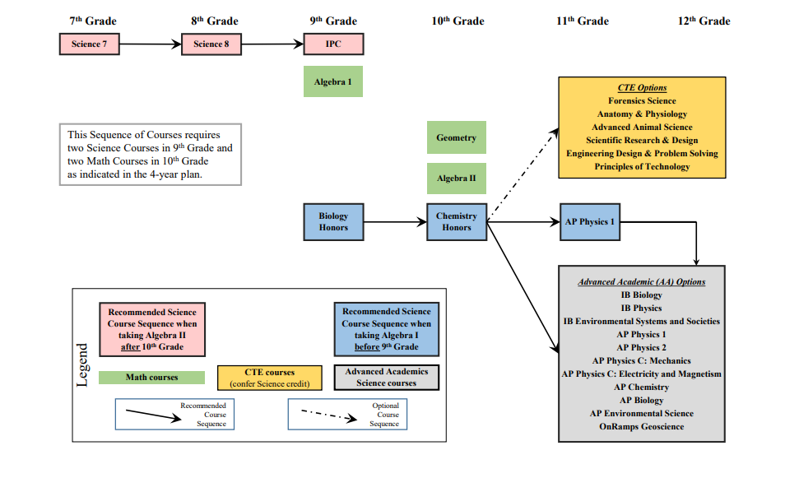
Honors Science: Option 2

Slide 43
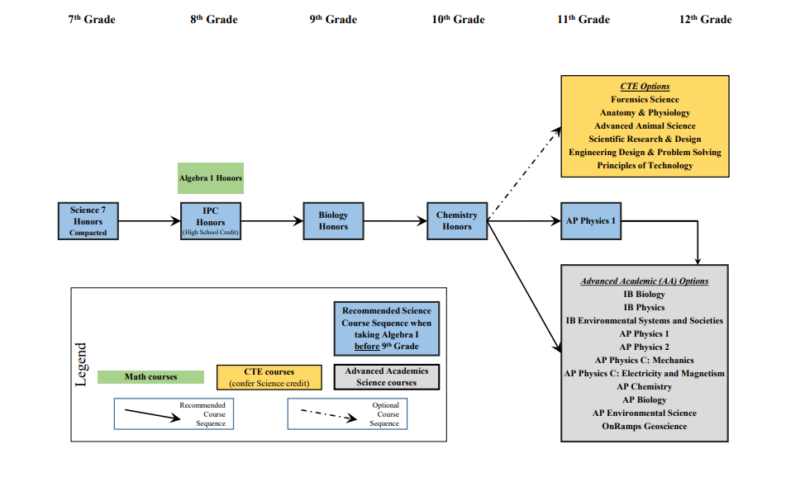
Honors Science: Option 3

Slide 44
Contact Information
Honors History: farrah.couch@rockwallisd.org
Honors Math: michael.tollison@rockwallisd.org
Honors Science: meridith.cooper@rockwallisd.org
SAGE English: molly.felfe@rockwallisd.org
Honors English: dorothy.cover@rockwallisd.org

